Slide 1
ArcGIS
ArcGIS

Slide 2
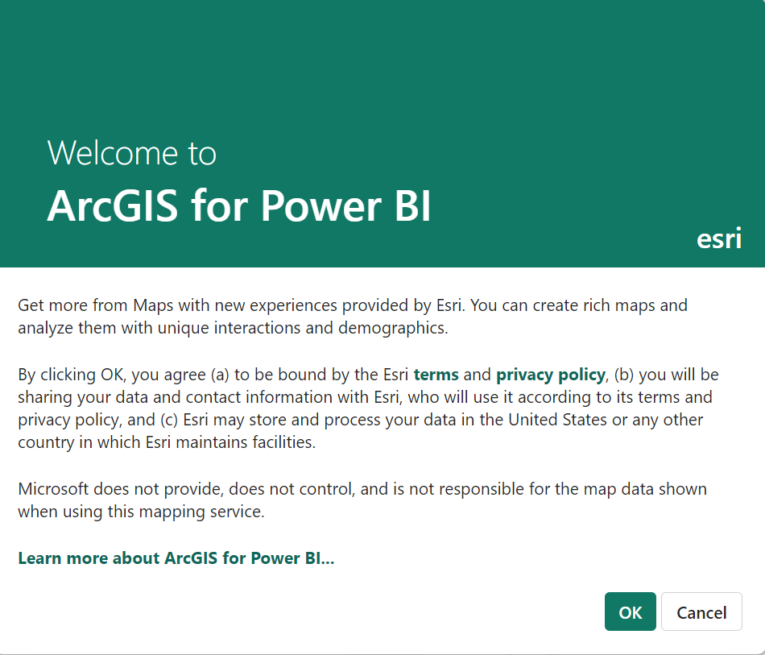
ArcGIS
Note: To complete This laboratory you must be connected to the Internet and have an account at http://www.arcgis.com
You must create a 21-day trial account
Or sign in with a Microsoft account

Slide 3
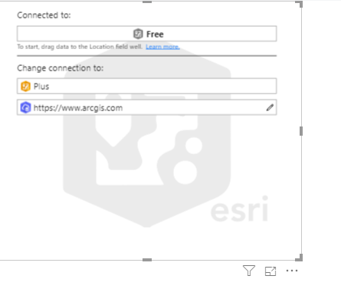
ArcGIS
Click OK in the dialog box .

Slide 4
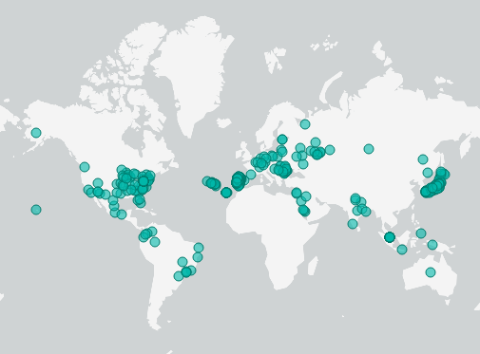
ArcGIS
Click Edit just below right in the More options menu
Enter the connection settings and see what happens it happens
Then enter the Location field in the Location setting level

Slide 5
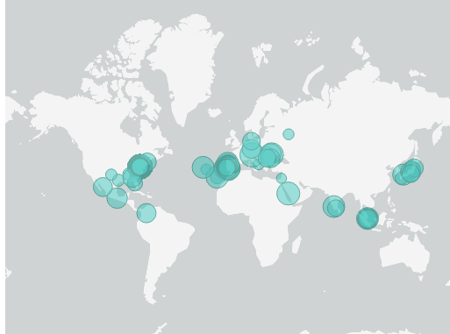
ArcGIS
In the Size parameter enter the average profit value and observe the change
Add the City field to Tootip setting

Slide 6
Thanks you
Thanks you

